Slide 1
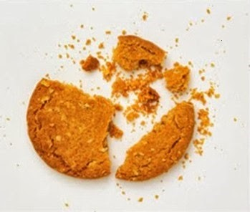

Test Automation Using Selenium
Fair Hike Academy
That’s the way the cookie crumbles!
Session 6: Introduction to Java
Mentor : Naresh Vulli, CSTE, PAHM.
fairhike@gmail.com www.fairhike.blogspot.com | www.facebook.com/fairhike

Slide 2
Today’s Topics
Recap
Java - WORA
JVM, JDK and JRE
Code Structure
Main Method
Simple Java Program
Execute Java Program
Takeaways or Exercise

Slide 3
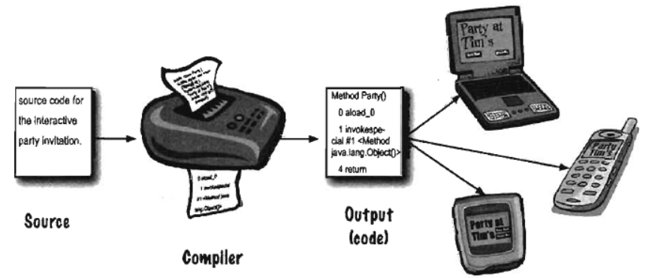
Java - "Write once, run anywhere" (WORA)

Slide 4
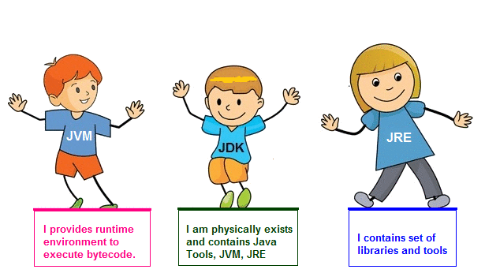
JVM, JDK and JRE

Slide 5
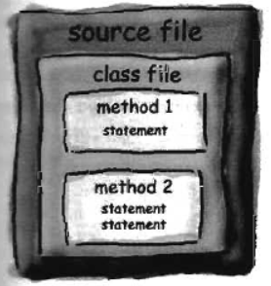
Code Structure
Source code file (with the .java
extension) holds one class definition
A class has one or more methods
Developer Tools
Method code is basically
a set of statements. It can be termed as a function or procedure.

Slide 6
Main Method
public static void main (String() args[])
{
//statements
}
When the JVM starts running, it looks for the class you give it at the command line.
Then it starts looking for a specially-Written main() method

Slide 7
Simple Java Program
class MyFirstProg
{
public static void main(String args[])
{
System.out.println(“Welcome to FairHike Academy!");
}
}
Write above code in a text File
Save as MyFirstProg.java

Slide 8
Execute Java Program
Open Command Prompt window
Navigate to Java file location using CD DOS command
Compile using “javac <java file name>” command
javac MyFirstProg.java
Run the program using “ java <classname>” command
java MyFirstProg

Slide 9
Takeaway or Exercise
Create a sample java program and execute using command prompt

Slide 10
Q & A

Slide 11
Thank You ☺

